Slide 1
W3C Web of Things (WoT) Update
Michael McCool
June 2021

Slide 2




W3C Web of Things (WoT)
W3C WoT Working Group goal: Adapting web technologies to IoT
Published: Thing Description (TD) metadata format
TD describes the available interactions (network API) of a Thing
In Progress: TD 1.1 Update, Thing Models, Discovery, Profiles
How to obtain TDs? How to ensure interoperability?
App
App
App
App
App
App
WoT API
WoT API
WoT API
{ properties, actions, events }
MQTT
KNX
TLV
ECHONET
Bearer
EXI
HTTP
OAUTH2
WS
XML
MQTT
KNX
TLV
ECHONET
Bearer
EXI
JSON
Modbus
CBOR
OPC-UA
API Key
HTTP
OAUTH2
CBOR
WS
XML
BACnet
AMQP
JSON
Modbus
BACnet
OPC-UA
API Key
AMQP

Slide 3

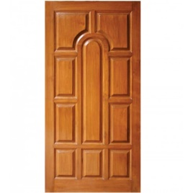

WoT Thing Descriptions
{
"@context": [
"https://www.w3.org/ns/td",
{ "iot": "http://iotschema.org/" }
],
"id": "urn:dev:ops:32473-WoTLamp-1234",
"title": "MyLEDThing",
"description": "RGB LED torchiere",
"@type": ["Thing", "iot:Light"],
"securityDefinitions": ["default": {
"scheme": "bearer"
}],
"security": ["default"],
"properties": {
"brightness": {
"@type": ["iot:Brightness"],
"type": "integer",
"minimum": 0,
"maximum": 100,
"forms": [ ... ]
}
},
"actions": {
"fadeIn": {
...
WHAT the possible choices are
Properties
Events
Actions
HOW to interact with the Thing
Protocol operations and options
Data schemas and content types
Security requirements
Pull
Handle = Affordance
What?
How?
Door = Thing
Open
Turn

Slide 4
Usage Patterns

Slide 5
Current WoT WG Charter Work Items
Architectural Requirements, Use Cases, and Vocabulary
Understand and state requirements for new use cases, architectural patterns, and concepts.
Link Relation Types:
Definition of specific link relation types for specific relationships.
Observe Defaults:
For protocols such as HTTP where multiple ways to implement "observe" is possible, define a default.
Implementation View Spec:
More fully define details of implementations.
Interoperability Profiles:
Support plug-and-play interoperabilty via a profile mechanism
Define profiles that allow for finite implementability
Thing Models:
Define how Thing Descriptions can defined in a modular way.
Complex Interactions:
Document how complex interactions can be supported via hypermedia controls.
Discovery:
Define how Things are discovered in both local and global contexts and Thing Descriptions are distributed.
Identifier Management:
Mitigate privacy risks by defining how identifiers are managed and updated.
Security Schemes:
Vocabulary for new security schemes supporting targeted protocols and use cases.
Thing Description Vocabulary:
Extensions to Thing Description vocabulary definitions.
Protocol Vocabulary and Bindings:
Extensions to protocol vocabulary definitions and protocol bindings.

Slide 6
New Deliverables
Thing Description 1.1
Canonicalization (and WIP, Signing)
Validation levels
Thing Model
various other extensions, e.g. to security, data schemas, etc.
Discovery
Introductions: DNS-SD, DID, CoRE RD
Directory Service: HTTP API for searchable database of TDs
Self-Description: .well-known, fetching of TD directly from Things
Profiles
Emphasis on "hub" use-case, http/json
Use Cases and Requirements (informative document)

Slide 7
Thing Description 1.1: Updates
Canonicalization and Signing
WIP, but proposal is based on JOSE/JWS/JWA (incl. RFC 8037)
Can extract parts of a TD to sign using JSONPointer/JSONPath/XPath queries
Security Scheme Improvements
URI Templates
Security information in body
OAuth "device" flow
Thing Model
TD describes instance, TM describes class
Provides templating/parameterization mechanism
TD can reference one TM using a link
TMs can reference or extend other TMs (and parts of other TMs)

Slide 8
Discovery: Goals
Capabilities
Support both local and global/remote discovery (unconstrained by network domain)
Support "localizable" discovery (constrainable by location)
Support both "syntactic query" (keywords) and "semantic query" (linked data)
Support a directory service for searching large repositories of Things
Support peer-to-peer (self-identifying "smart object") discovery
Privacy-Preserving Architecture
Respect device and information Lifecycle
Distribute TDs only to authenticated and authorized users
Don’t leak private data to unauthorized users
Don’t leak data that can be used to INFER private information to unauthorized users
Alignment with Existing and Evolving Standards
IETF CoRE Resource Directories, CoRE Link Format, DID, OGC, WGS84, XPath, …
Compatible with WoT Scripting API

Slide 9
Discovery: Two-Phase Architecture
Phase 1: Introduction
“First Contact” Protocol
Answers the question: How to initiate discovery from zero knowledge?
Open
Can be accessed with no or limited access controls
Based on existing standards, and can be extended to new standards
Lightweight
Does not use significant resources on responder
Resistant to Denial of Service attacks
Provides intentionally limited information
Avoid leaking any metadata that can be used to infer private data
This includes types of devices, device ids, owners, timestamps, etc.
Phase 2: Exploration
Authentication and authorization required
Supports more complex query and filtering capabilities (JSON Path, XPath, SPARQL)
Provides access to rich metadata (TDs)
Access controls can limit data returned

Slide 10
Discovery: Status
Introductions
DNS-SD (including mDNS) – new service names
CoRE RD – resource types
DID – endpoint types
Well-known URLs: to "guess" URL from an IP
Direct: anything else that returns a URL
Note: link types distinguishing a Directory and a Thing are useful but not mandatory
Exploration
"Smart Objects": Retrieve TD directly from Thing
Directory service API: described using a TD
Provides multiple query types:
JSONPath – mandatory
XPath – optional
SPARQL – optional
Pagination, etc.

Slide 11
What is a WoT Profile?
A WoT Profile is a normative subset of a WoT Thing Description with a normative binding to a selected protocol.
Profiles guarantee interoperability between compliant implementations, multiple profiles are possible.
The WoT Profile Specification defines a normative set of constraints and rules on the data model, representation format and protocol binding.
These constraints and rules provide clarifications and make decisions that reduce the complexity for implementers of the WoT standard.
The rules are prescriptive, to ensure that compliant implementations satisfy the semantic guarantees implied by them.

Slide 12
Profiles: Constraints
Constraints on | Rationale | Example
vocabulary of Thing Description classes | guaranteed set of metadata fields | Make specific vocabulary terms mandatory, remove others
class relationships | unambiguous structure | limited cardinality, e.g. only one form per operation per interaction affordance.
values of vocabulary terms | simplified processing | Limit the length of characters per string. Always use arrays, where the spec permits a string or an array of strings.
data schemas | simplified processing | Limits on nesting
security | reduced implementation effort | Only a restricted set of security mechanisms
protocol binding | guaranteed protocol semantics | limited protocol(s) and protocol features, Example: predefined mapping of http verbs (GET/PUT) to operation verbs, similar constraints for other protocols.

Slide 13
Profiles: Current Work
Defining a core/baseline profile with a HTTP binding.
Identifying constraints and rules on the data model.
Unambiguous interaction semantics for properties, actions and events.
Constraints on payload formats.
Protocol binding semantics, e.g. headers, response codes.
Security constraints.
Representation format constraints.

Slide 14
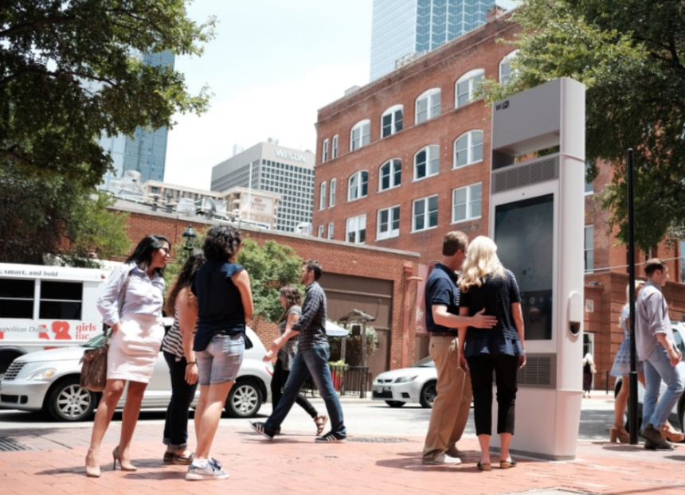

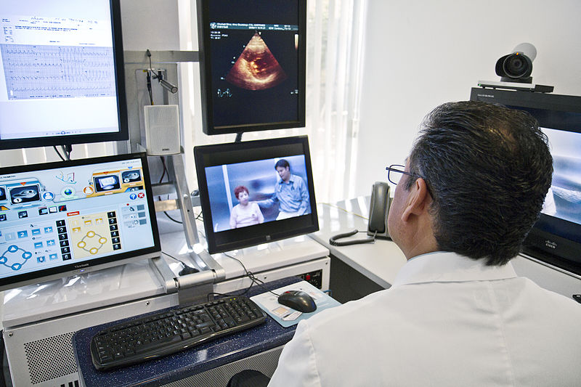
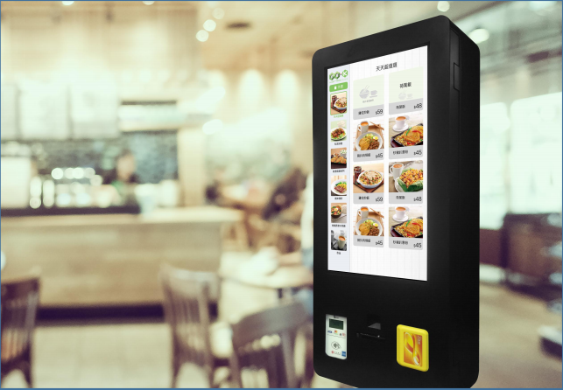
Use Cases: W3C Smart City Workshop
Visitor Guidance
Energy Management
Others
Law Enforcement
Parking
Accessibility
Traffic and Logistics
Public Transportation
Air Quality and Weather
Cultural Space Mgmt
Construction Services
Land Management
Emergency Services
Water Management
Hybrid Ruralization
Health
Retail Services

Slide 15
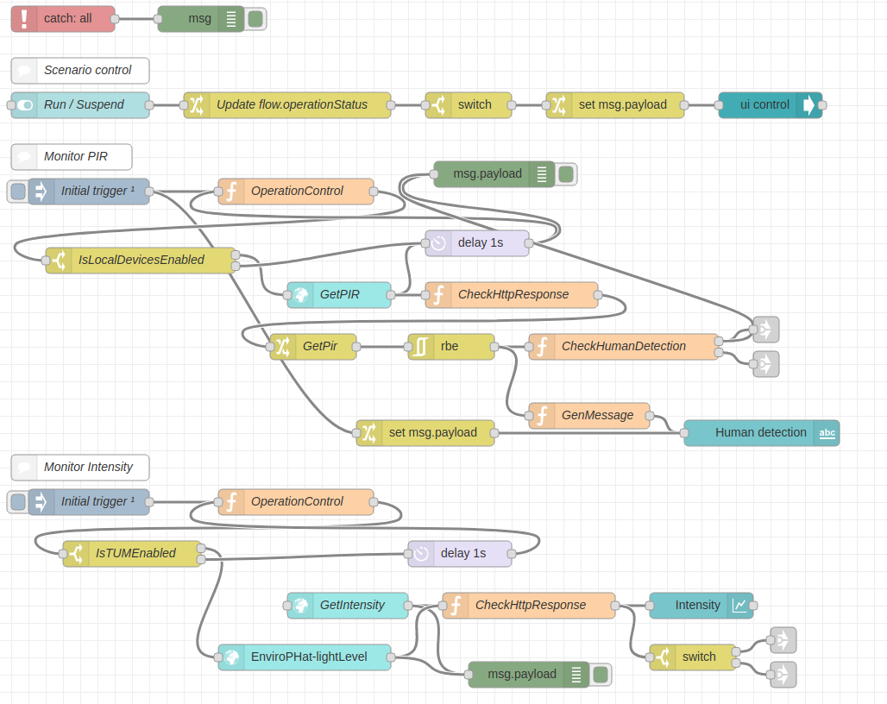

WoT Orchestration
node-wot/Scripting API
Node-RED/node-gen
WoTHelpers.fetch( "coap://localhost:5683/counter" ).then( async (td) => {
// using await for serial execution (note 'async' in then() of fetch())
try {
let thing = await WoT.consume(td);
console.info( "=== TD ===" );
console.info(td);
console.info( "==========" );
// read property #1
let read1 = await thing.readProperty( "count" );
console.info( "count value is" , read1);
// increment property #1 (without step)
await thing.invokeAction( "increment" );
let inc1 = await thing.readProperty( "count" );
console.info( "count value after increment #1 is" , inc1);
// increment property #2 (with step)
await thing.invokeAction( "increment" , {'step' : 3});
let inc2 = await thing.readProperty( "count" );
console.info( "count value after increment #2 (with step 3) is" , inc2);
// decrement property
await thing.invokeAction( "decrement" );
let dec1 = await thing.readProperty( "count" );
console.info( "count value after decrement is" , dec1);
} catch(err) {
console.error( "Script error:" , err);
}
}).catch( (err) => { console.error( "Fetch error:" , err); });

Slide 16
Documents and Resources
New/Updated Normative Documents in Draft Status:
Architecture 1.1: https://github.com/w3c/wot-architecture
Thing Description 1.1: https://github.com/w3c/wot-thing-description
Discovery: https://github.com/w3c/wot-discovery
Profiles: https://github.com/w3c/wot-profile
New/Updated Informative Documents in Draft Status:
Binding Templates: https://github.com/w3c/wot-binding-templates
Scripting API: https://github.com/w3c/wot-scripting-api
Use Cases and Requirements: https://github.com/w3c/wot-usecases
Other Resources:
Web Site: https://www.w3.org/WoT/

Slide 17
Contacts
https://www.w3.org/WoT
Dr. Michael McCool
Principal Engineer
Intel
Technology Pathfinding
michael.mccool@intel.com
Dr. Sebastian Kaebisch
Senior Key Expert
Siemens
Technology
sebastian.kaebisch@siemens.com

Slide 18
Backup

Slide 19
Image Credits
Solar Installation Vietnam: By Intel Free Press - https://www.flickr.com/photos/intelfreepress/7169063498/sizes/o/in/photostream/, CC BY 2.0, https://commons.wikimedia.org/w/index.php?curid=28011974
Telemedicine Consult: By Intel Free Press - https://www.flickr.com/photos/intelfreepress/6948764580/sizes/o/in/photostream/, CC BY 2.0, https://commons.wikimedia.org/wiki/File:Telemedicine_Consult.jpg

